Slide 1
Fiscal barriers for smart charging
Baerte de Brey

Slide 2
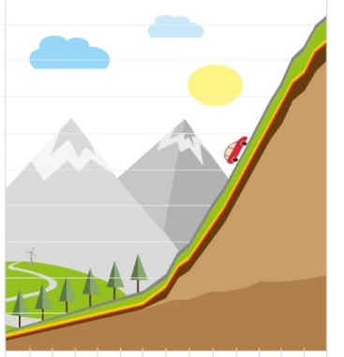
High penetration of electric vehicles & infrastructure
Over 115.000 EV’s
11.768 public charging stations
14.320 semi-public chargers
600+ fast chargers
+ 72.000 private charging stations

Slide 3

VISION
18:00
00:00
06:00
12:00
18:00
Storage
Smart Charging
Sustainable energy
Smart mobility

Slide 4
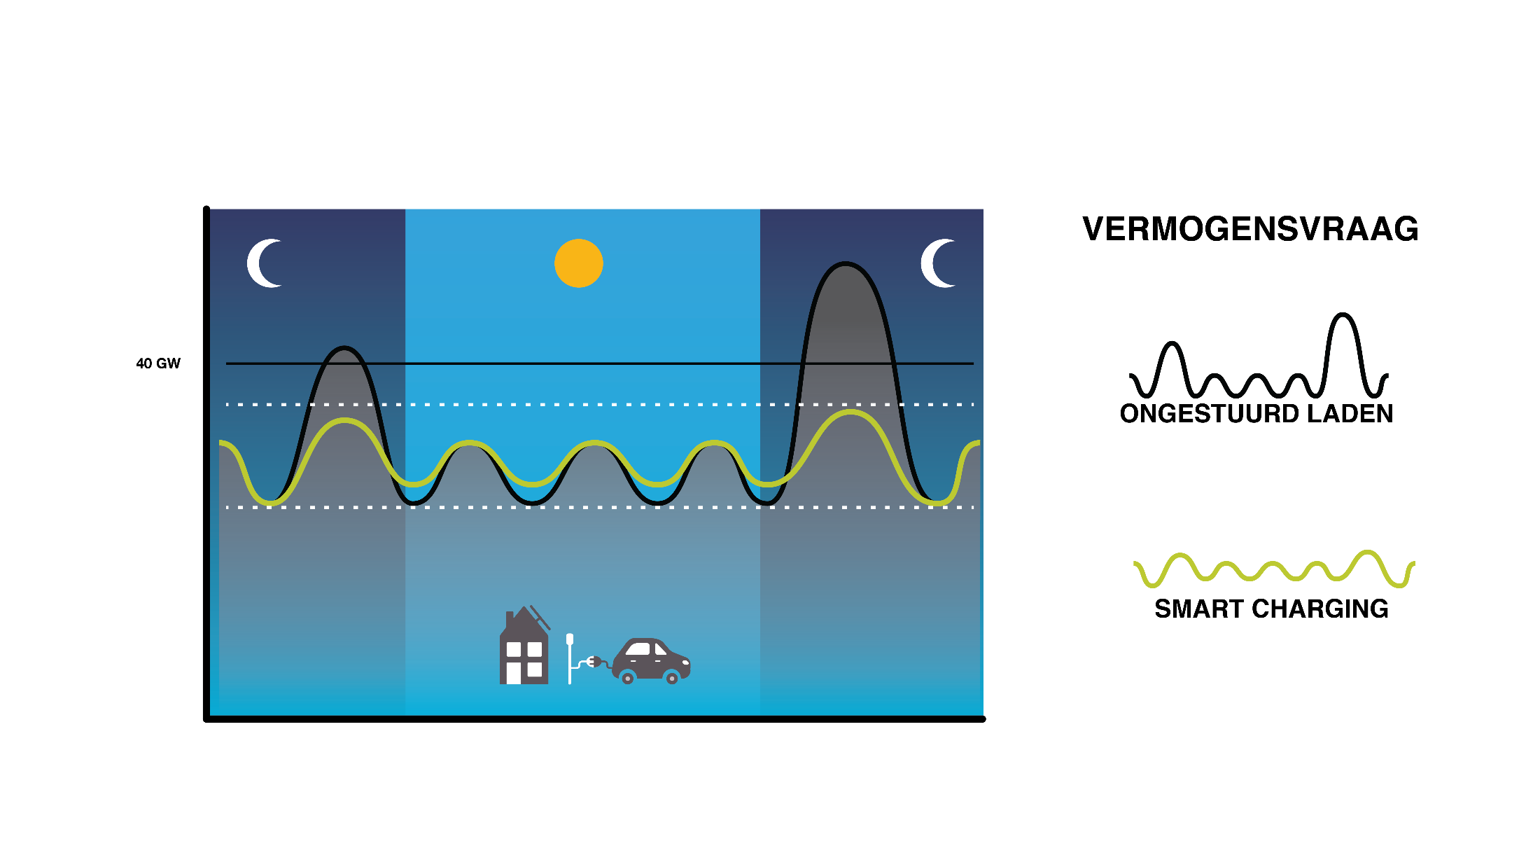
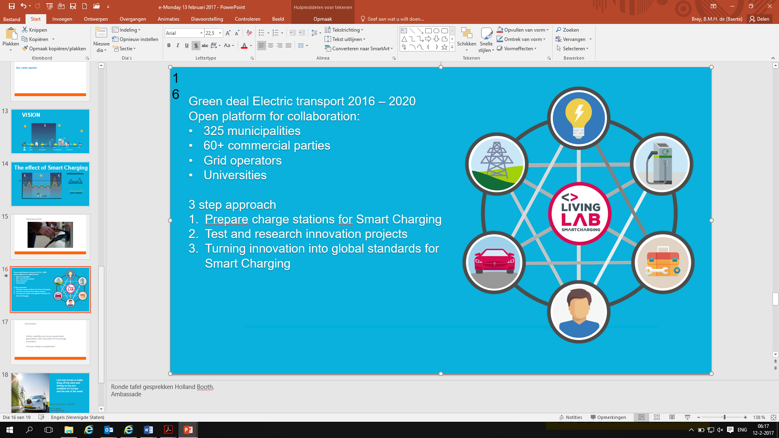
The effect of Smart Charging

Slide 5
Overview of Smart Charging chain
Aggregation of an EV fleet to provide services and grid services
Regional & local
National
Clearing house – Processing transactions
Power generator
Open clearing house protocol – Information on charging stations of all connected CPOs
Clearing house
Aggregator
PROD
Connected electric car
Provider / Programme responsible
Charge point operator – Installing and maintaining charging points
OCHP
OCHP
Electric mobility service provider – Mobility products and services (charging card)
LV / PV
OEM
EV
CP
CPO
eMSP
61851
OCPP
OCPI
15118
Open charge point protocol – Communication CPO and grid CPs
energy contract
European standards
DSO
TSO
Original equipment manufacturers – electric vehicle manufacturers
Smart meters
Charging point – Charging point for electric vehicles
Open charge point interface – Information on site, availability and charging station features
Distribution system operator - Regional grid operator
Transmission system operator - National grid operator
Source: Alliander (2016), PwC analysis

Slide 6
Regulatory questions
Does this qualify as supply?
Between what parties is supply effected?
How does Smart Charging relate to netting?
How does Smart Charging relate to the self-generated power exemption?

Slide 7
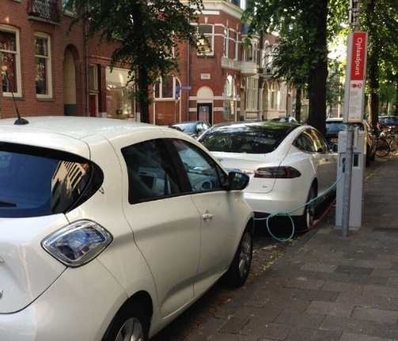
Four case studies
1
Lomboxnet
Charging and discharging power by means of EVs is tested in the Lombok residential area in the city of Utrecht.
A number of solar PV systems are directly linked to charging points in the area.
The bi-directional charging points allow generated solar energy to be stored temporarily in EVs and to be re-delivered at a later time.
This increases own use or allows storage to be used to balance the grid.

Slide 8
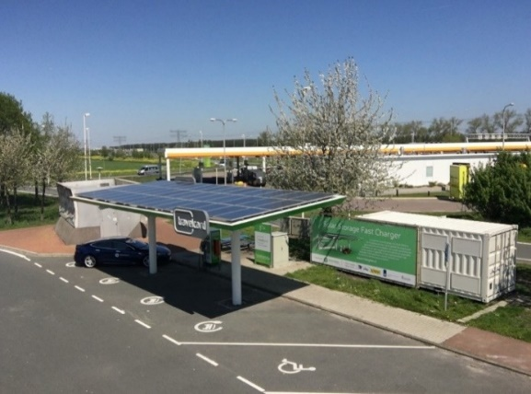
3
Haarrijn
Fast charging point for EVs along the A2.
The configuration consists of a solar PV system, a charging station for 4 EVs and a battery system.
The power consumption from the grid is lower due to storing of solar energy in the battery.
This allows the grid operator to avoid investments (grid upgrade).

Slide 9
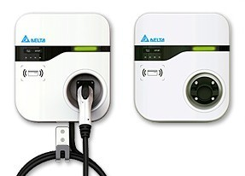
2
Logical allocation
Consumption is no longer registered on the charging point connection but on a virtual connection to a service provider.
This allows EV users to switch between energy providers at the charging point, since energy contracts have been concluded with the service provider and not with the charging point owner.
The advantage for an EV user is that this could entail a cost benefit at the charging point.
A service provider can aggregate EV users to offer flexibility options.
Provider A
Provider B

Slide 10



4
Flex power
Flexpower is an initiative to vary the grid connection capacity with consent from the connected party.
FlexPower aims to use idle grid capacity to charge electric cars. By smart charging outside peak hours, electric cars can be charged faster in public areas without causing congestion on the electricity grid.
This creates more efficient simultaneous usage, which may prevent congestion and possibly also avert net upgrades.

Slide 11

Missing incentive to optimise own consumption behind the meter in an EV
No (financial) stimulation for e-drivers with (their own) solar panels to optimally use the self-generated electricity

Slide 12
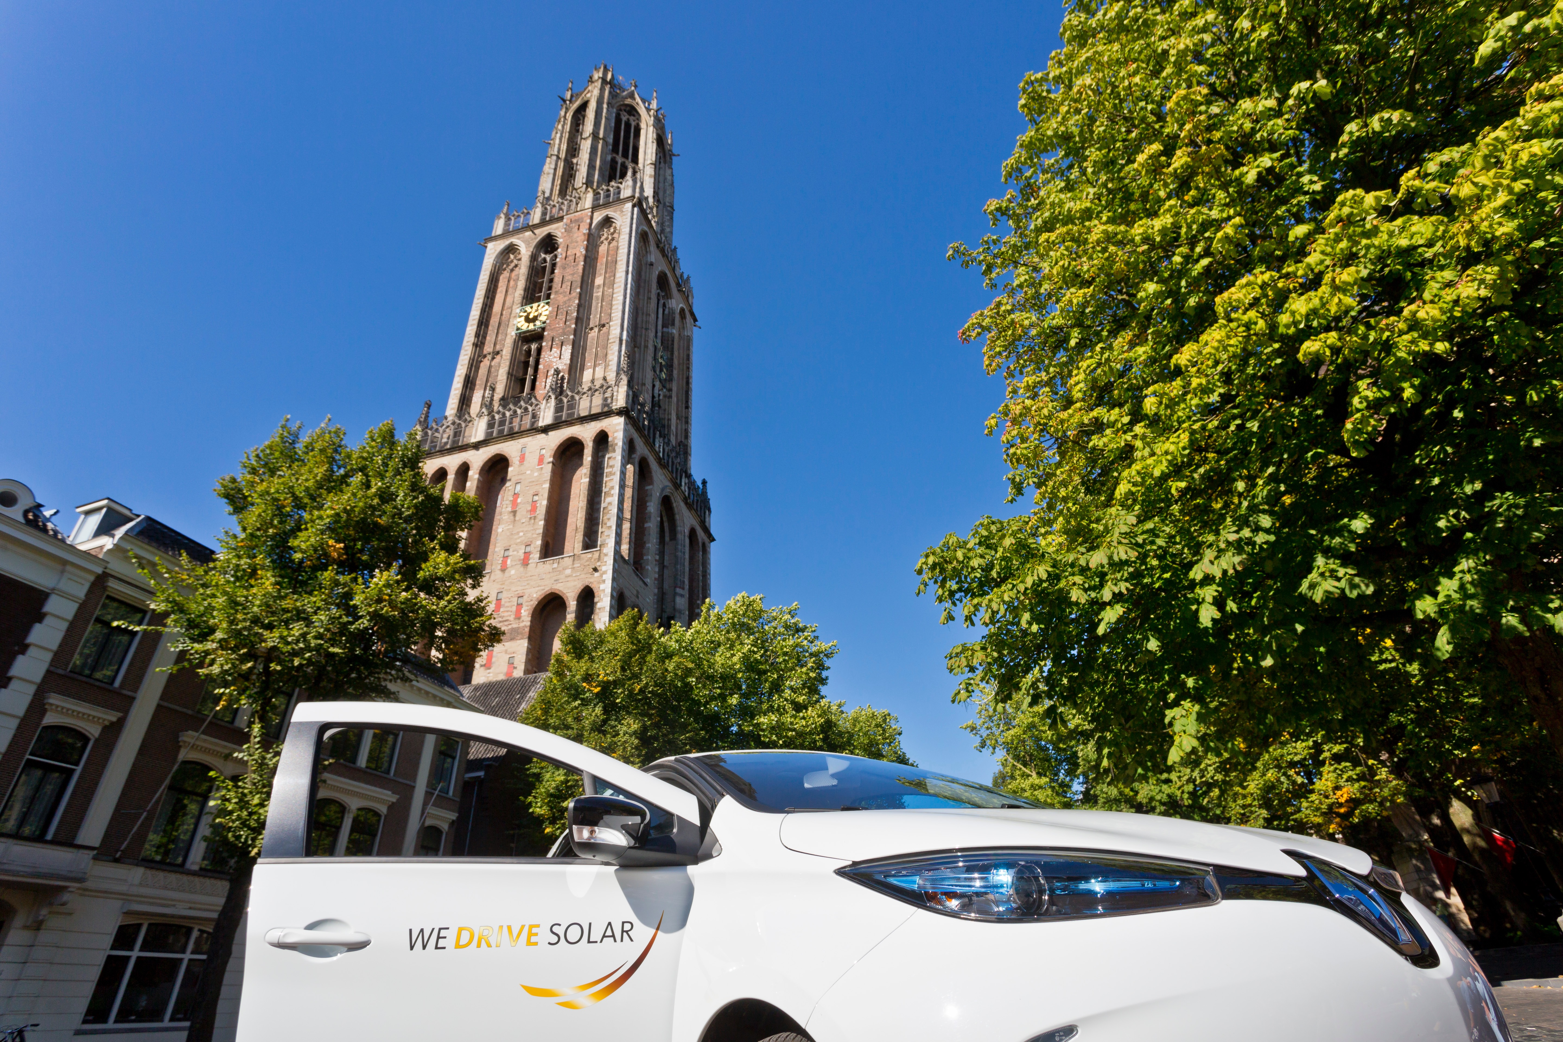
Possible double energy tax for V2G charging
Every time the car is charged again after discharging energy tax has to be paid

Slide 13

No incentive for the roll-out of charging infrastructure with maximum charge capacity for Smart Charging
Higher capacity of the connection, the faster a car can be charged
More flexibility generated for the use of the car for Smart Charging.
High capacity connection is significantly more expensive

Slide 14
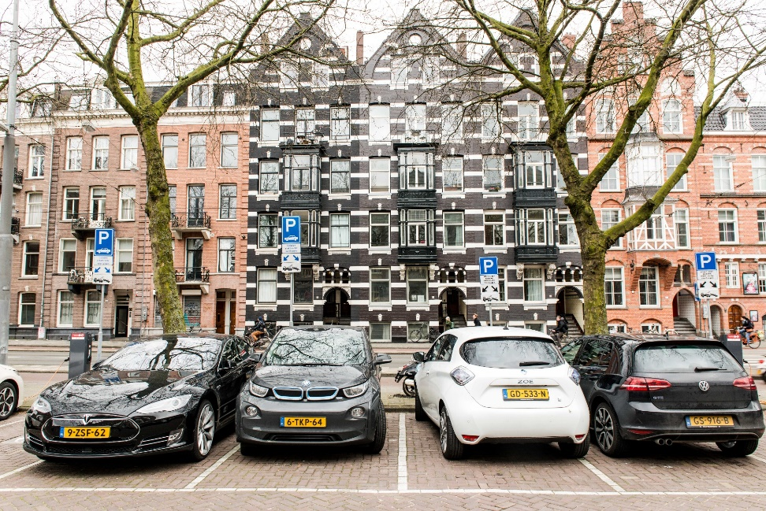
Possible incentive for Charge Point Operator to block Smart Charging
CPO: maximisation of Charge Point Occupancy
differs in some cases from the importance of other players
Risk that the CPO will intervene in the planned Smart Charging

Slide 15

Who determines the use of the electric car for Smart Charging?
E-driver has connected his electric car to several initiatives
which initiative takes precedence?

Slide 16
Other countries
Incentives on purchasing cars
Time of use, demand respons
Suntax

Slide 17
Questions?
Baerte de Brey
M: +31 6 11034826
E: Baerte.de.brey@elaad.nl

