Slide 1


Analysis of MV/LV-transformer load under several EV and PV penetration scenarios
Flexibility of electric vehicle (EV) demand
-
a case study
M.K. (Marte) Gerritsma, MSc. (Utrecht University),
dr. T.A. (Tarek) AlSkaif (Utrecht University),
H.A. (Henk) Fidder (Stedin),
dr. W.G.J.H.M. (Wilfried) van Sark (Utrecht University)

Slide 2


Content
Introduction
  Concept of smart charging
  Study design
Part 1: Data Analysis
  Methods
  Results
Part 2: Simulation
  Methods
  Results
Conclusion

Slide 3
Expected trends in NL
Number of electric vehicles
Number of EVs in the Netherlands, 2012-2030
High
Medium
Low
Expected trend
Current # EVs
From: Movares, Waarde van flexibel laden, 2016.

Slide 4
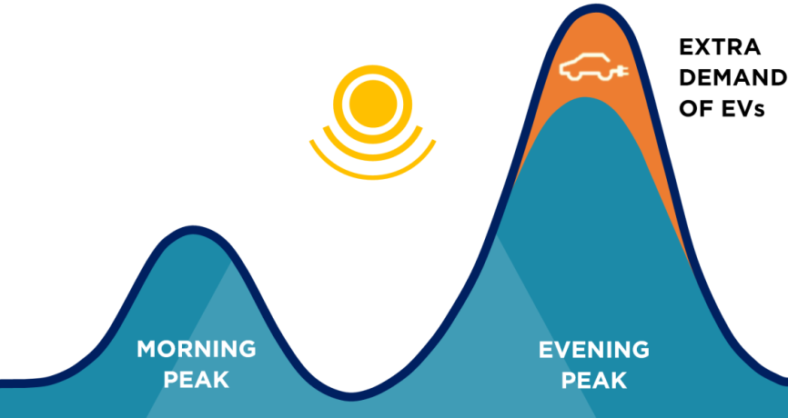
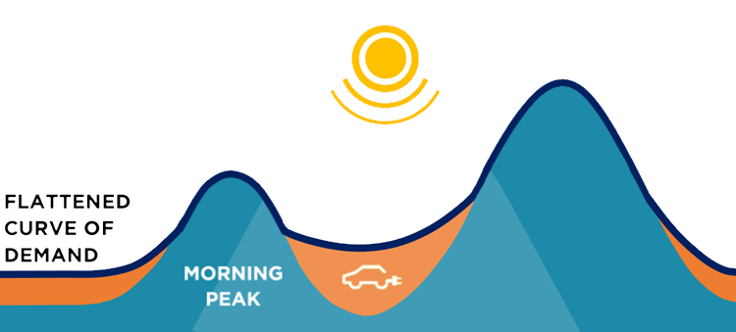
Introduction
Smart charging
Uncontrolled charging
Smart charging
Adjusted from: http://www.amsterdamvehicle2grid.nl/

Slide 5
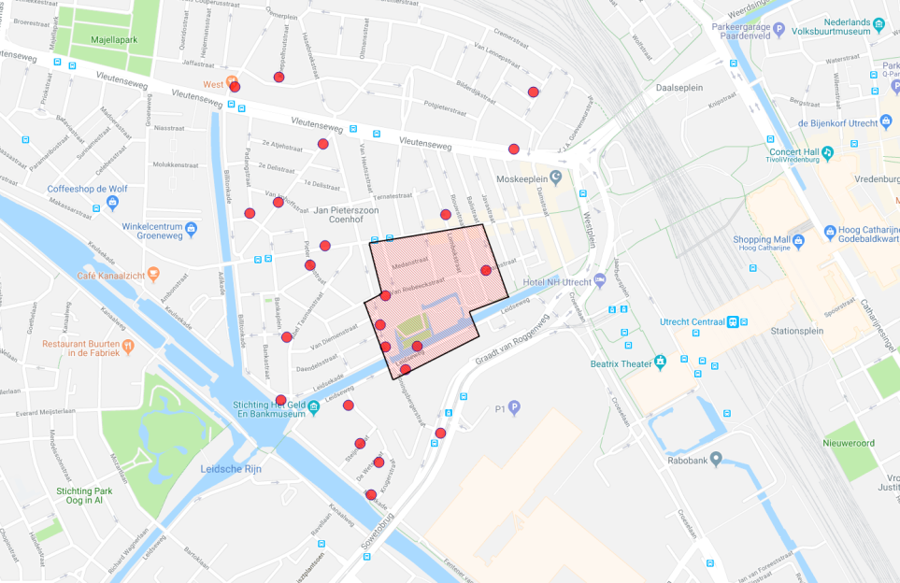
Study design
What is the impact and flexibility of current and future EV demand, based on historical charging data?
Case study: Lombok (Utrecht)
Part 1. Analysis of data 22 charging stations
Part 2. Simulation of future impact on one MV/LV transformer, connected to 350 households (red area)

Slide 6
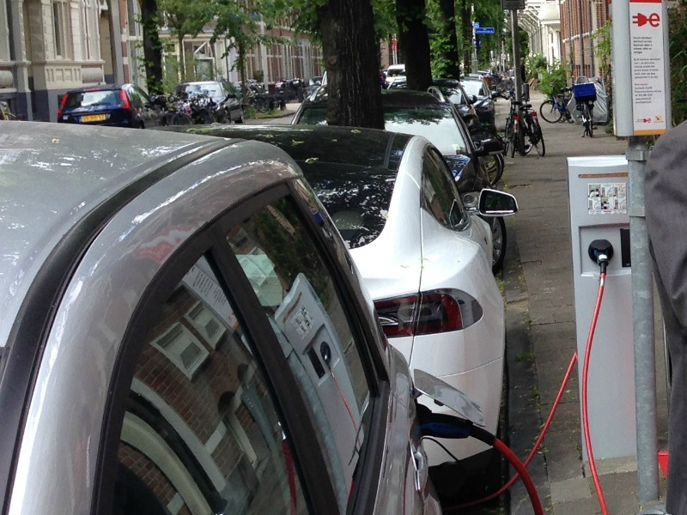
Study design
Period: June 1, 2017 – January 31, 2018
Available data at each charging station:
Transaction log (per transaction)
  EV ID
  Volume charged [kWh]
  Plug-in moment in time
  Plug-out moment in time
Power log
  Power delivered [kW]
Further available data:
  Local PV generation [kW]
  Net power at transformer [kW]

Slide 7
Methods data analysis
Subdividing EV IDs in groups

Slide 8
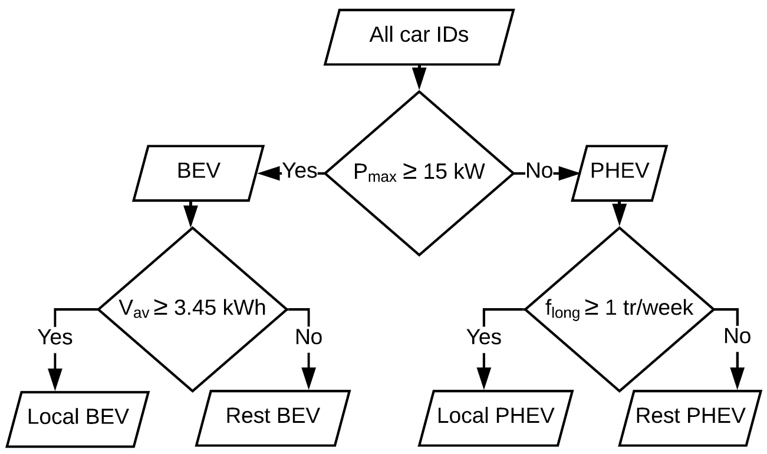
Methods data analysis
Subdividing EV IDs in groups
Parking duration > 6 hours
Charging ≥ 50% of energy within Lombok?*
* Based on 34.6 km/(car.day) and 5 km/kWh

Slide 9
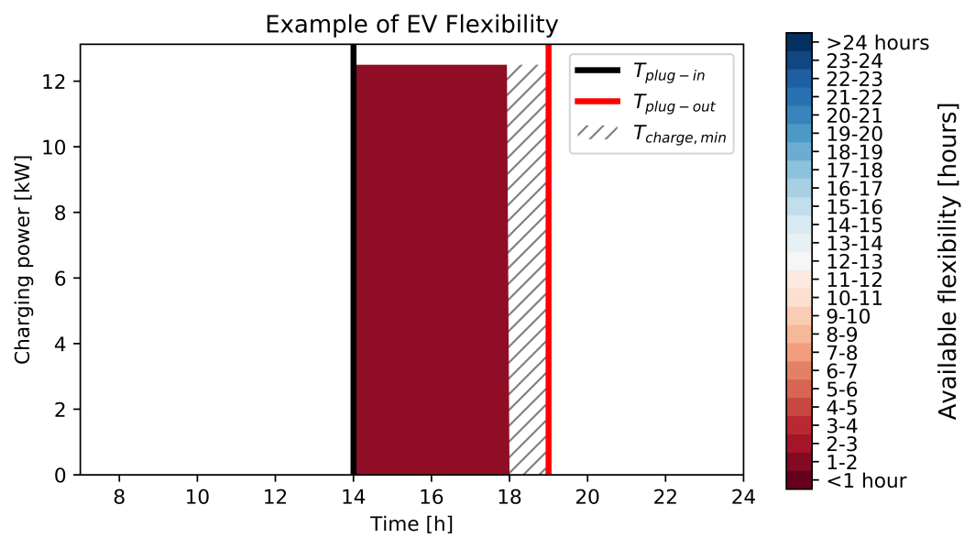
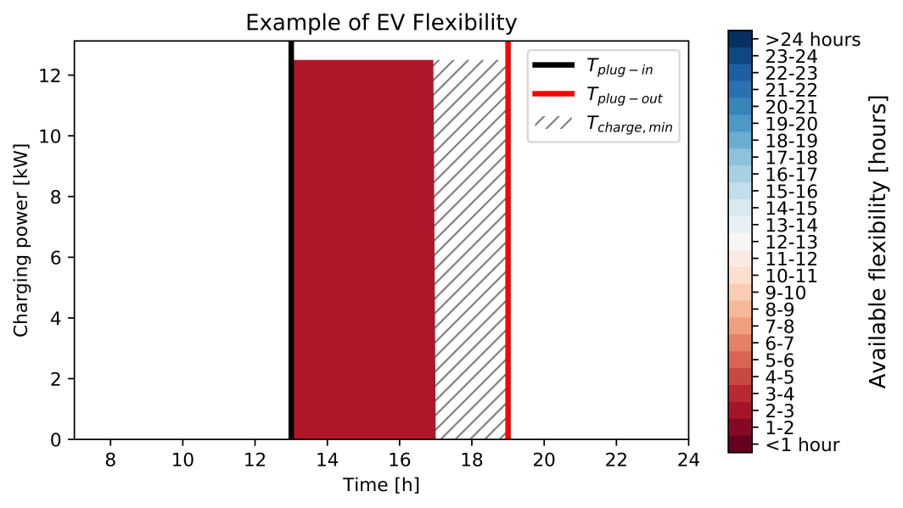
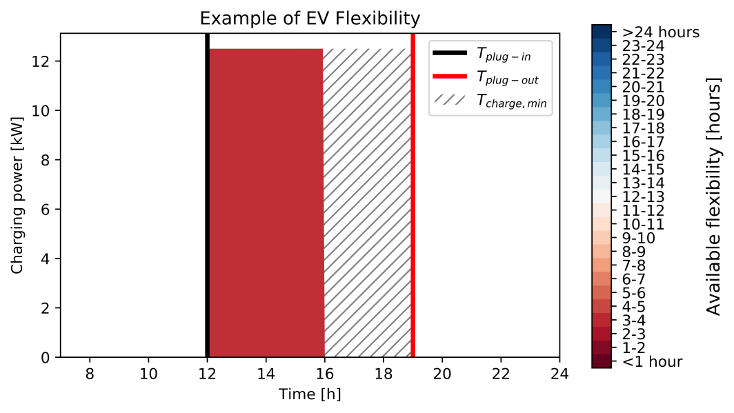
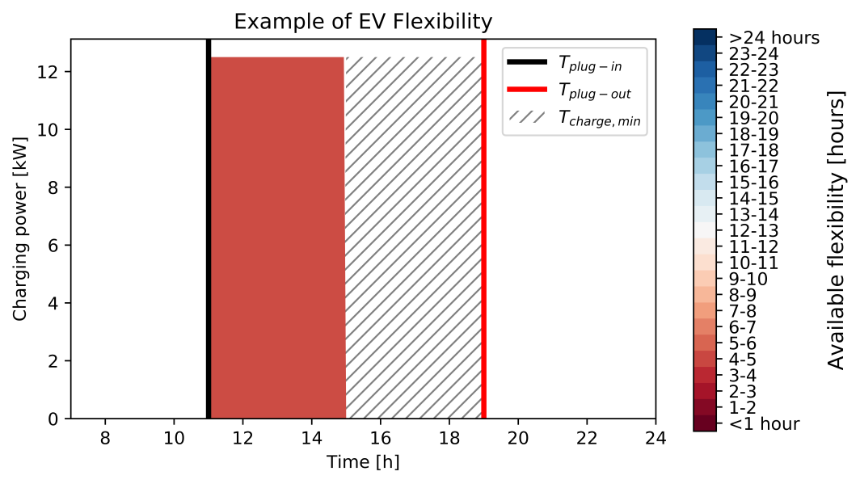
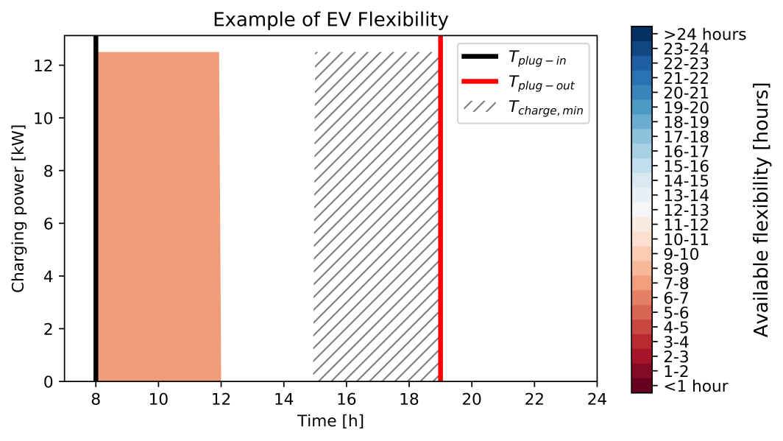
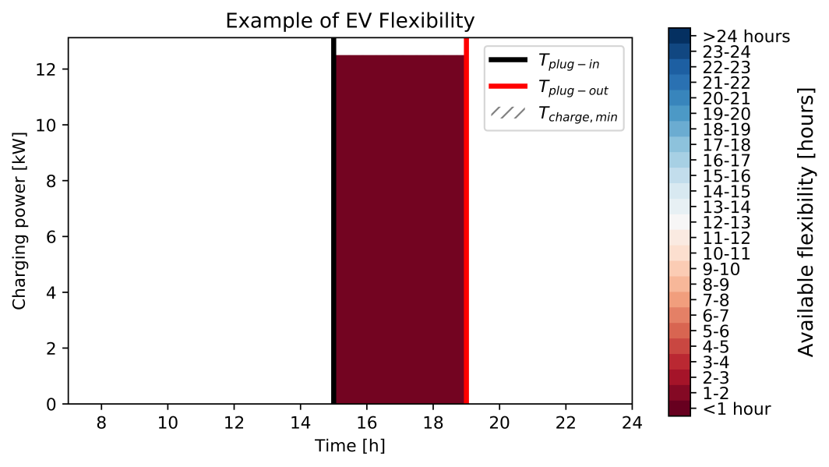
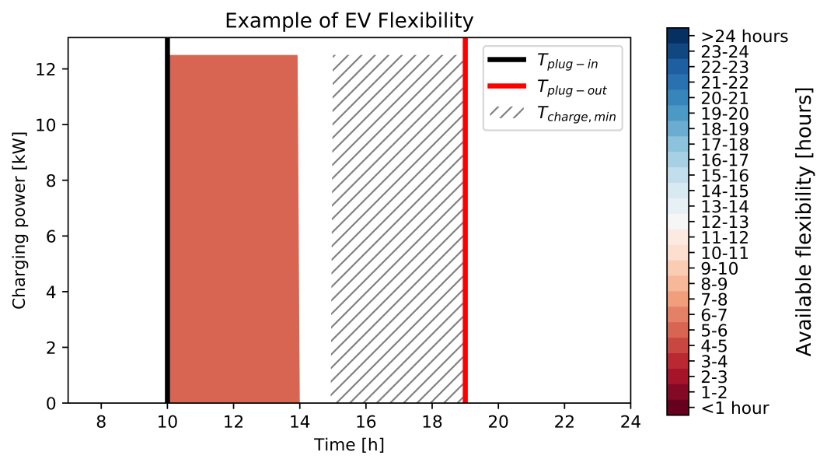
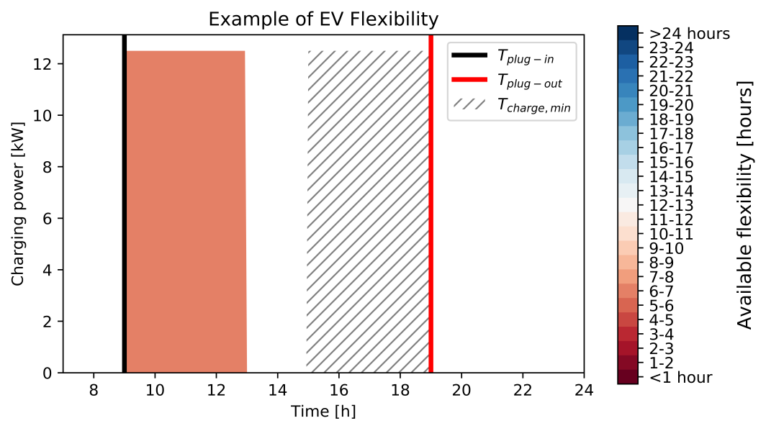


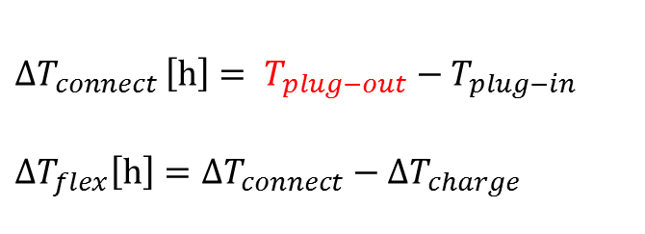

Methods data analysis
Flexibility analysis
$${ΔT}_{connect }\left[h\right]= T_{plug−out}−T_{plug−in}$$
$$ΔT_{flex}\left[h\right]=ΔT_{connect}−ΔT_{charge}$$
actual charging power
profile
charging power profile
with maximum delay
$${ΔT}_{connect}$$
$${ΔT}_{charge}$$
$${ΔT}_{flex}$$

Slide 10
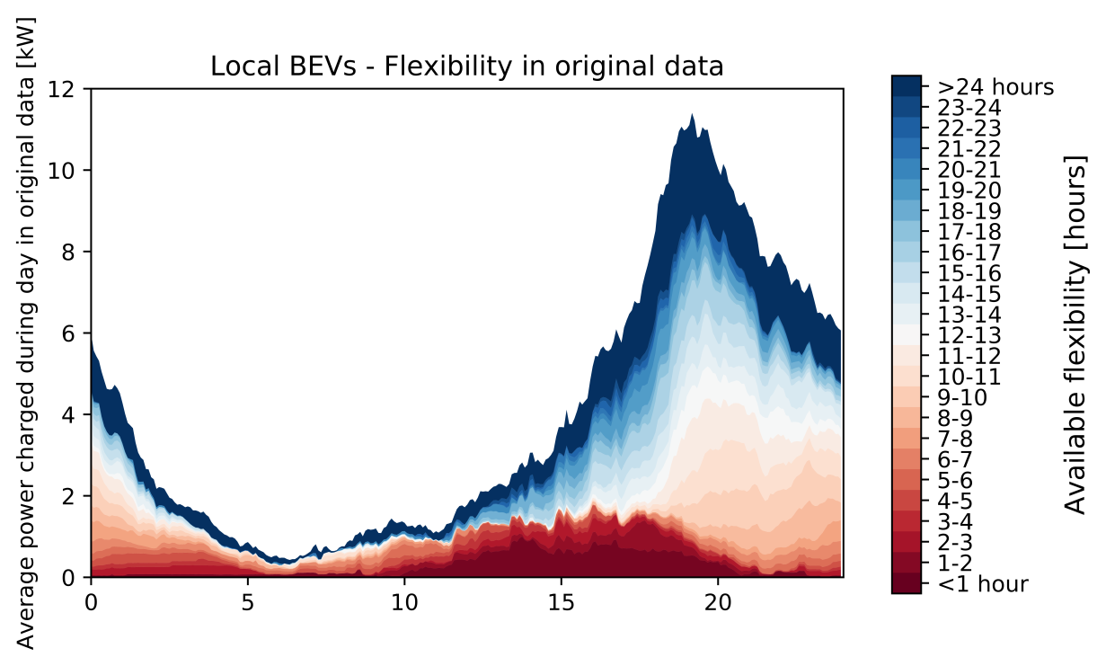
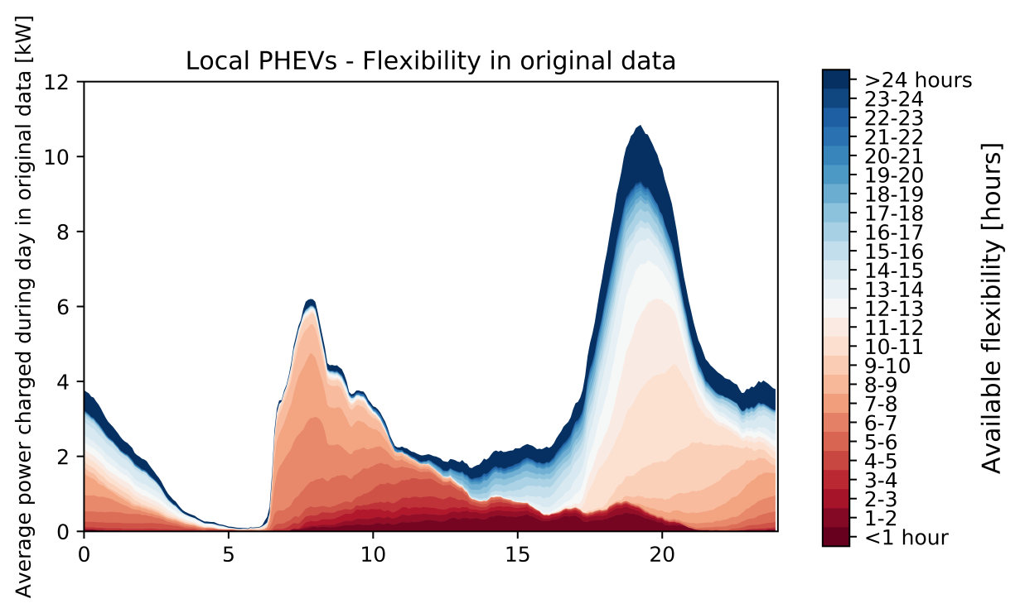
Results data analysis
Flexibility of EV demand – local cars
Average demand profile of groups over a day
Flexibility
> 12 h
hour of the day
hour of the day
15 local BEV IDs in dataset
freq_{av} = 0.436 tr/(car.day)
53 local PHEV IDs in dataset
freq_{av} = 0.354 tr/(car.day)

Slide 11
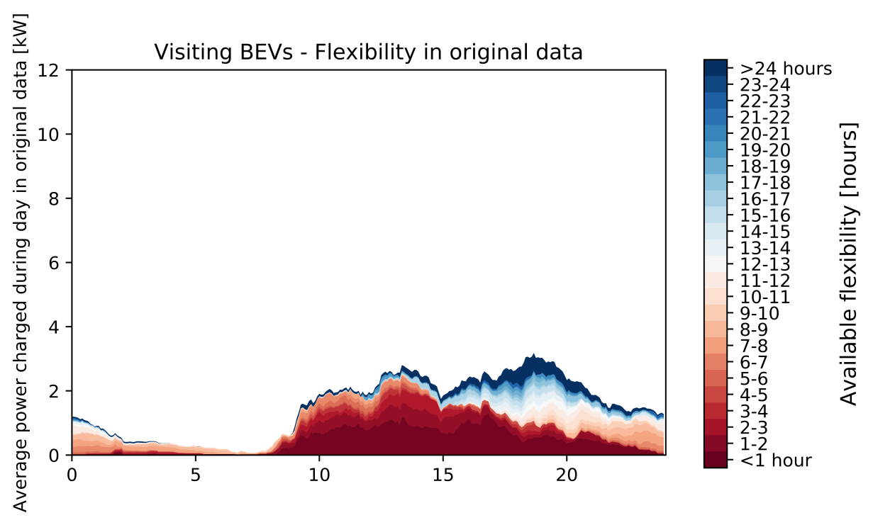
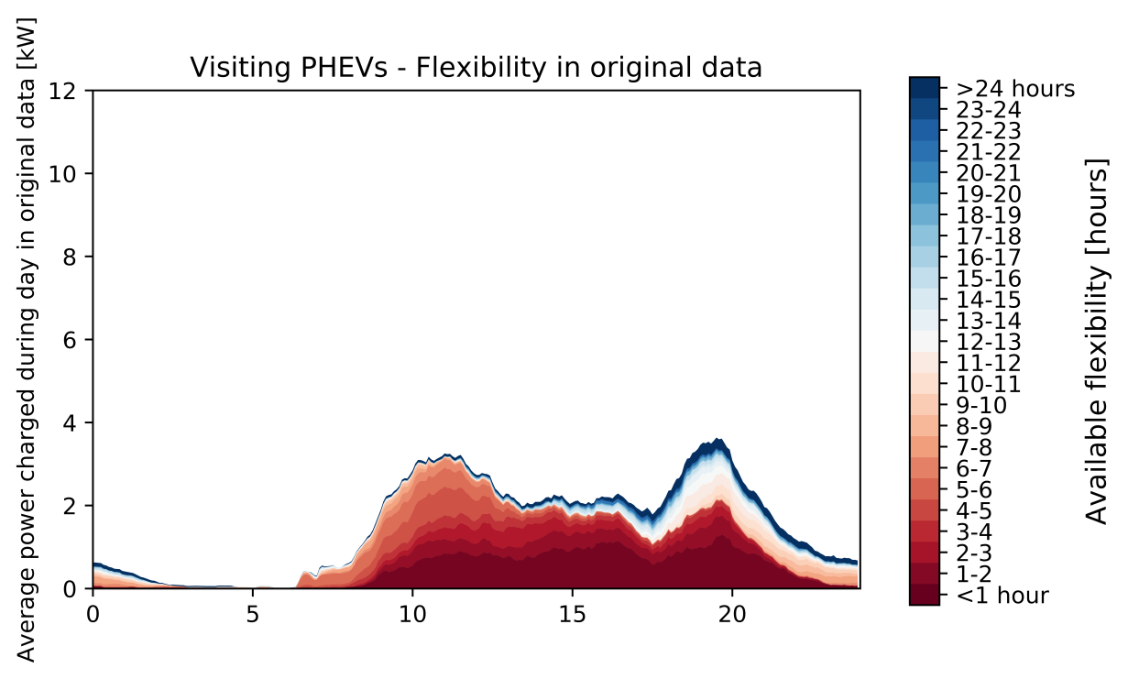
Flexibility of EV demand – visiting cars
Average aggregated demand profile of groups over a day
hour of the day
hour of the day
152 visiting BEVs in dataset
freq_{av} = 0.017 tr/(car.day)
487 visiting PHEV IDs in dataset
freq_{av} = 0.014 tr/(car.day)

Slide 12
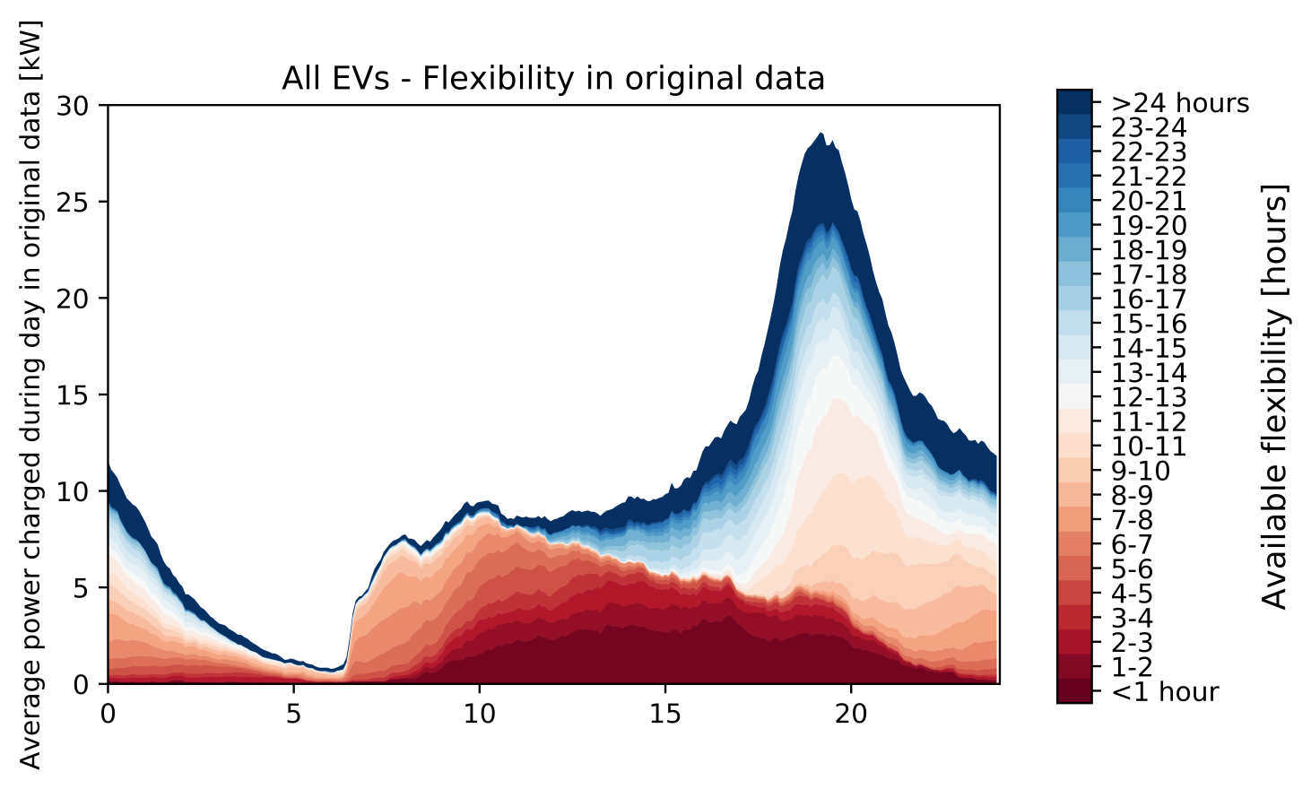
Flexibility of EV demand – all cars
Average demand profile all cars over a day
hour of the day

Slide 13
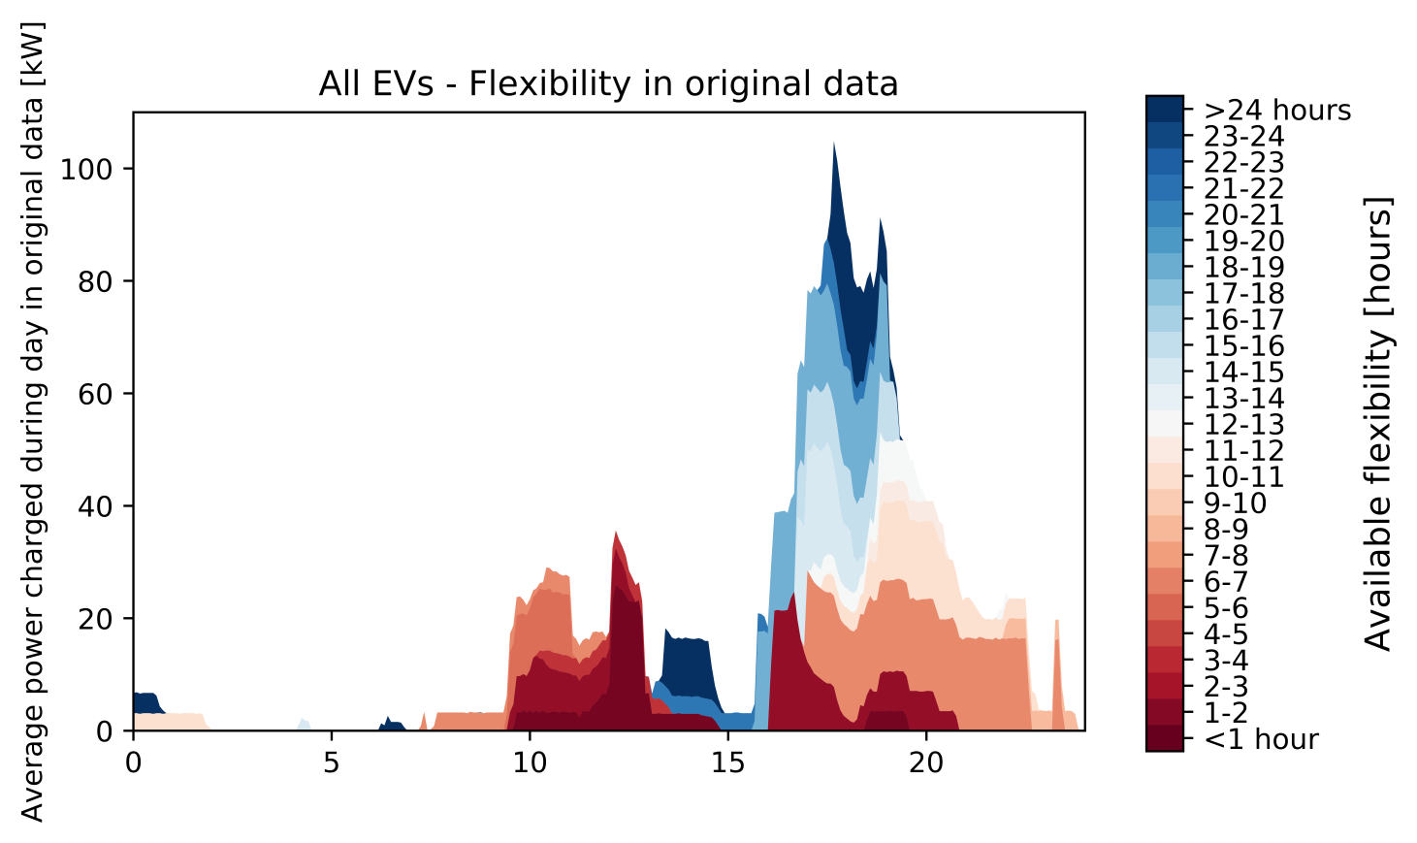
Flexibility of EV demand – all cars
Maximum EV peak day in analysed data
Aggregation of 22 charging stations
hour of the day

Slide 14
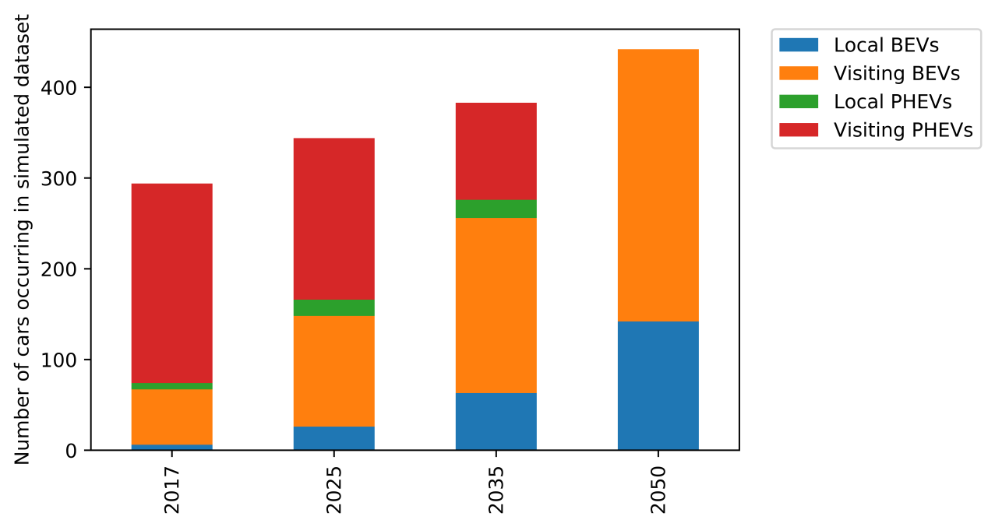

Methods simulation (350 HH area)
Scenarios EV simulation
Simulation of the impact of uncontrolled charging on one transformer (350 connected households, red area)
Transformer limit: 400 kW
Baseload kept constant

Slide 15
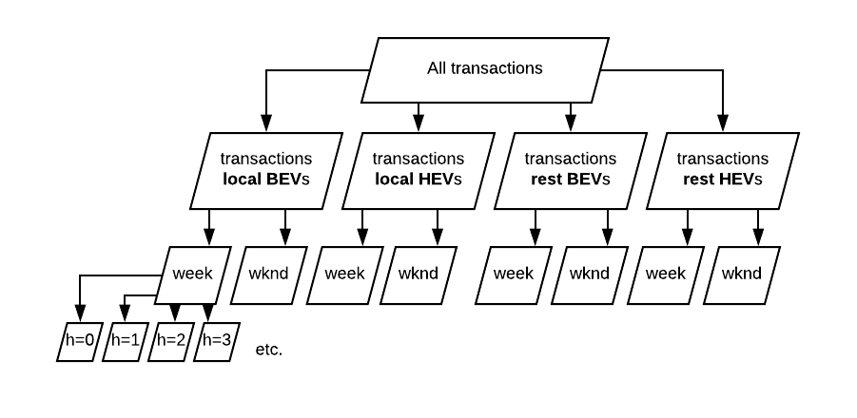
Simulation of transactions

Slide 16


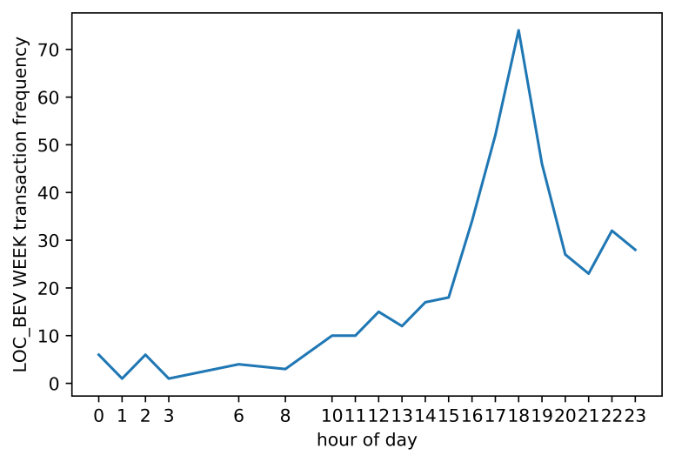
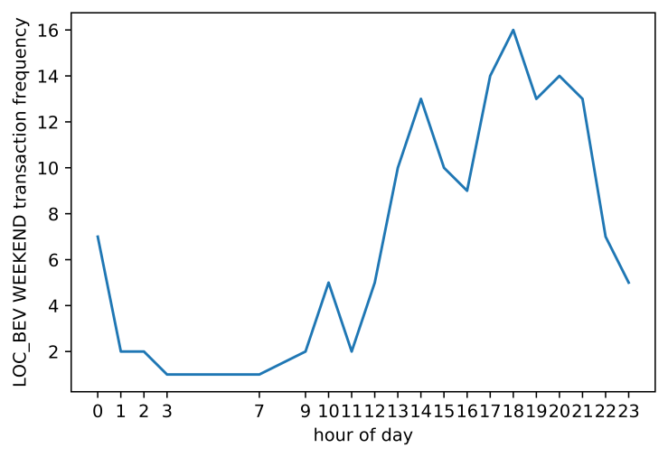
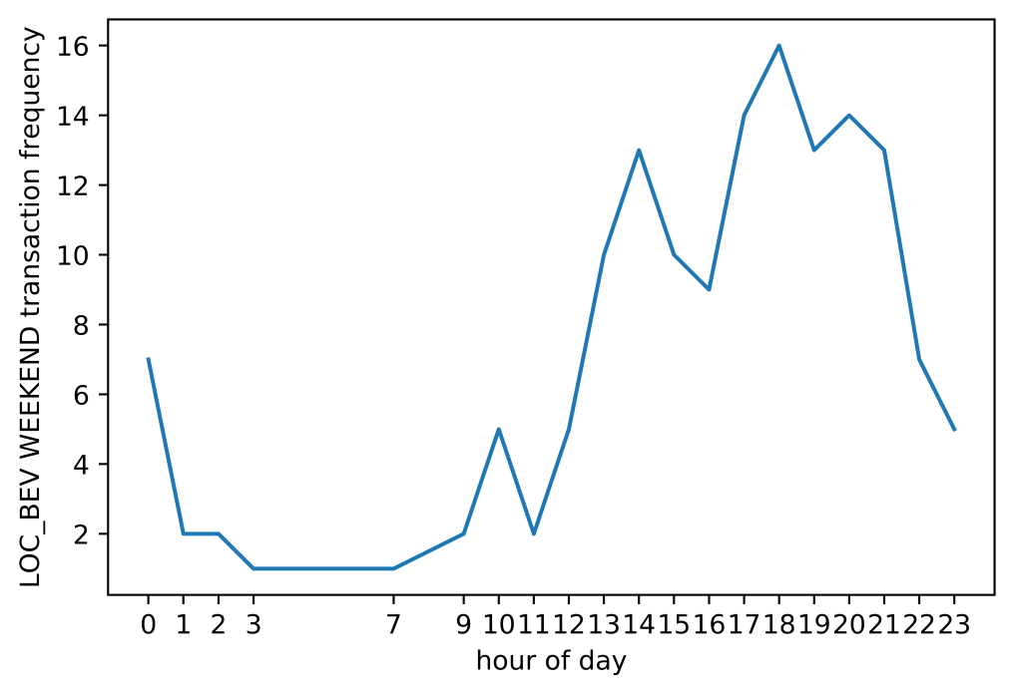
Simulation of transactions

Slide 17
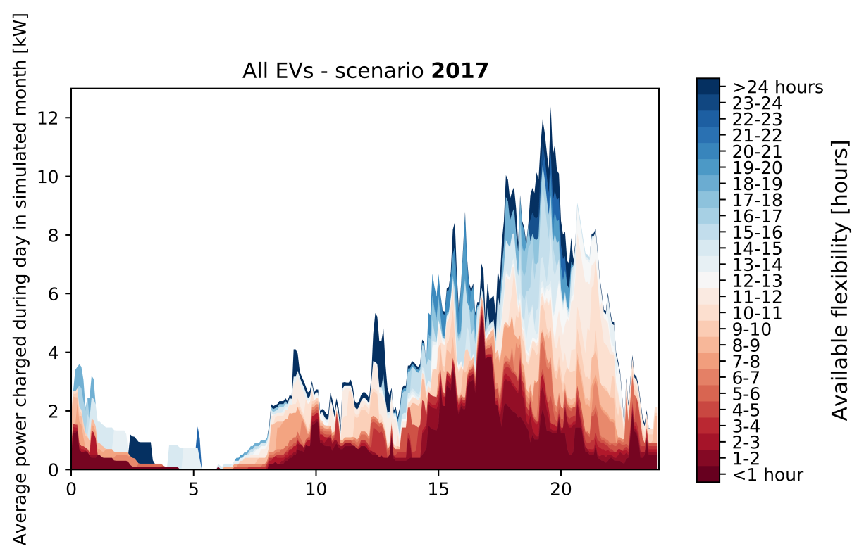
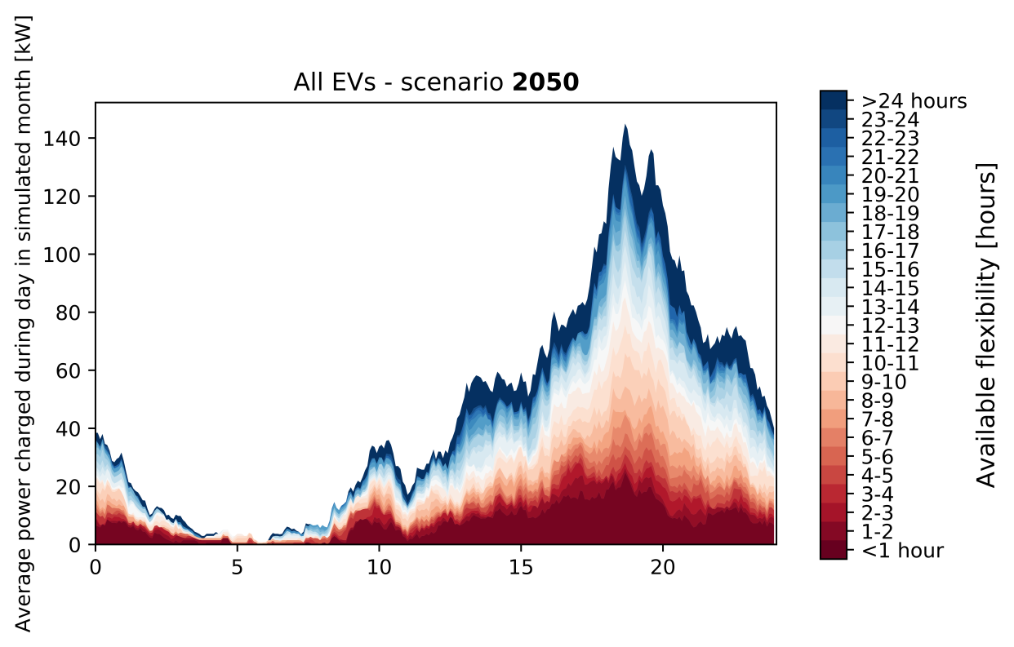
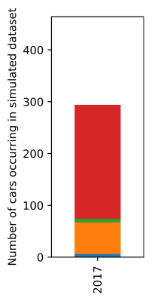
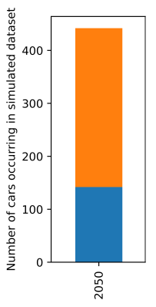
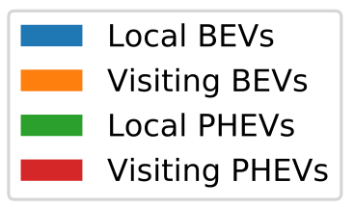
Results simulation (350 HH area)
Impact and flexibility EV simulation

Slide 18
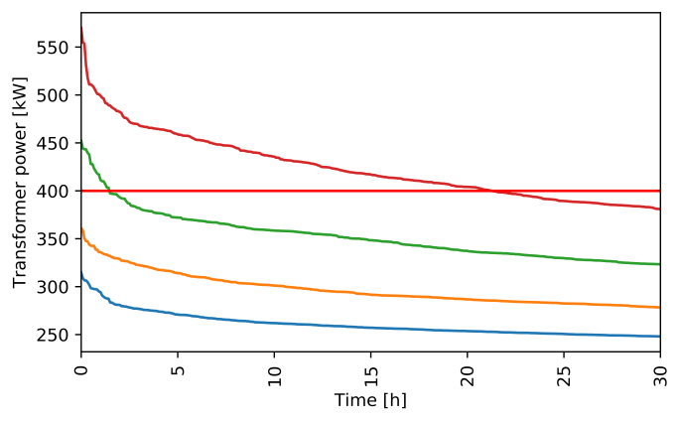
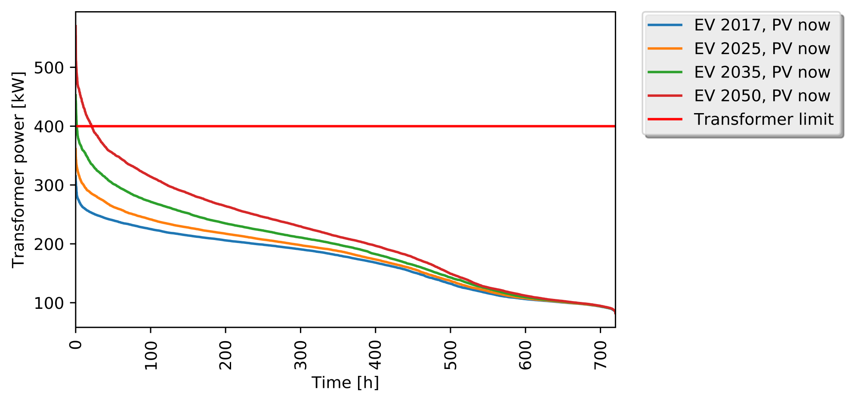
Transformer load duration curves
No congestion in ‘2017’ and ‘2025‘ scenarios
> 20 hours of congestion in ‘2050’ scenario in December

Slide 19
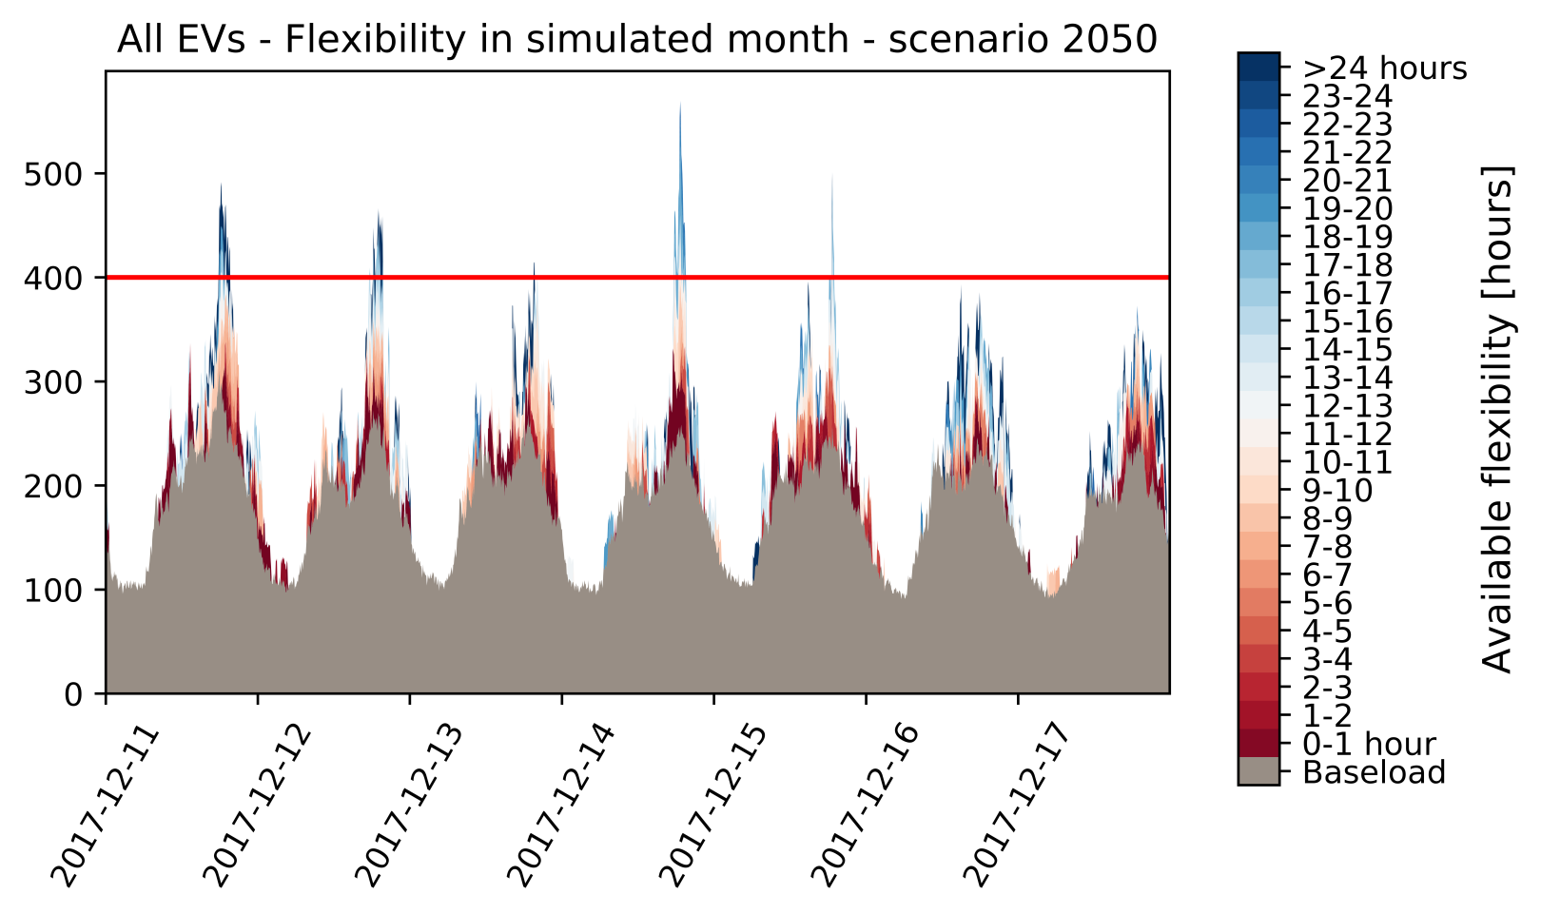
Transformer load
‘2050’ scenario, week in December
Monday
Tuesday
Wednesday
Thursday
Friday
Saturday
Sunday

Slide 20
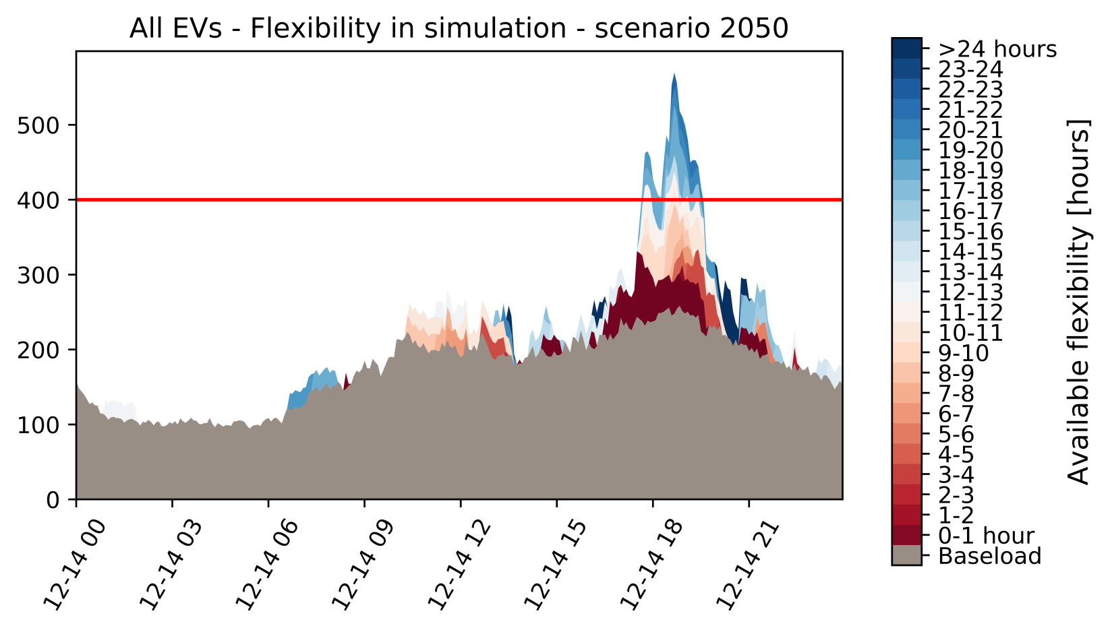
Transformer load
Day with maximum peak in simulated month December, ‘2050’
0
3
6
9
12
15
18
21

Slide 21
Conclusion
EV uncontrolled in residential networks is expected to cause congestion (for ≥ 63 local BEVs in a 350 HH area)
Local BEVs provide for lot of flexibility
Evening peaks show >12 hours flexibility for about 50% of demand
Future work:
Further quantification of (uncertainty of) flexibility availability
Investigate charging behaviour in other test grounds with different car usage
Testing effects of different peak shifting strategies within flexibility constraints

Slide 22
www.smartsolarcharging.eu
THANK YOU FOR YOUR ATTENTION

